Slide 1
EggBeater

Slide 2
Executive Summary: Purpose
Create an encryption system that provides superior file security
Tool for generating encryption keys from fingerprints
Open Source

Slide 3
Executive Summary:
Design and Methodology
MVC Architecture
Alterations
Agile Development
Modified Test-Driven Development
Unit Testing
Acceptance Testing
Object-Oriented Programming
Embedded Modifications

Slide 4
Research
GUI frameworks
Qt
Wxwidgets
Fingerprint modules
GT511C1R
Encryption libraries
Crypto++
OpenSLL, OpenAes, CyaSLL

Slide 5
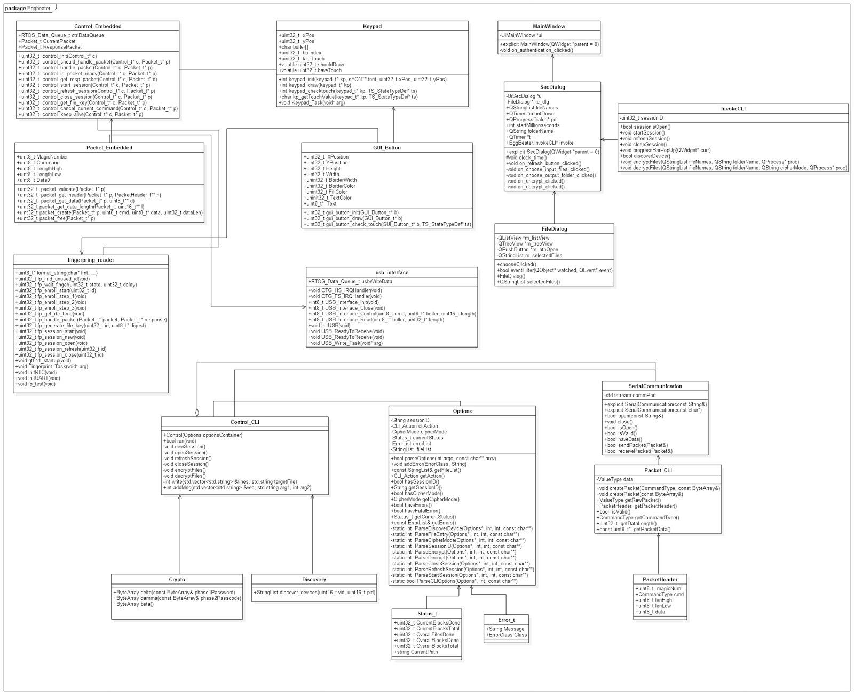
Design: Overall

Slide 6
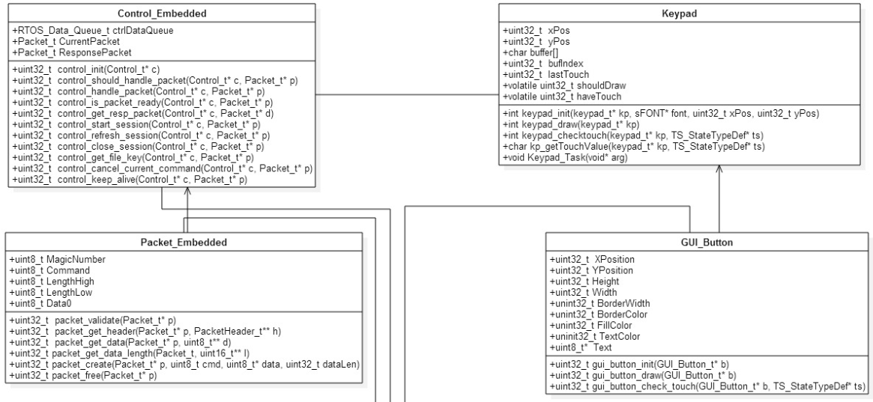
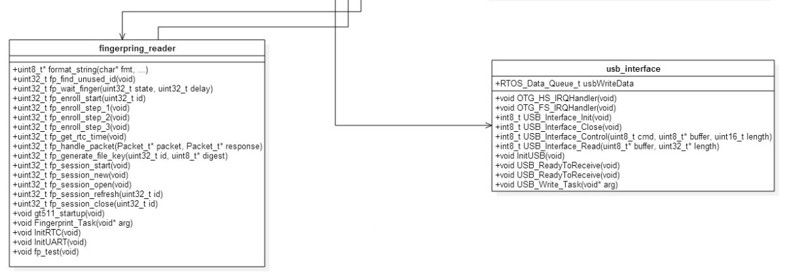
Design: Embedded

Slide 7
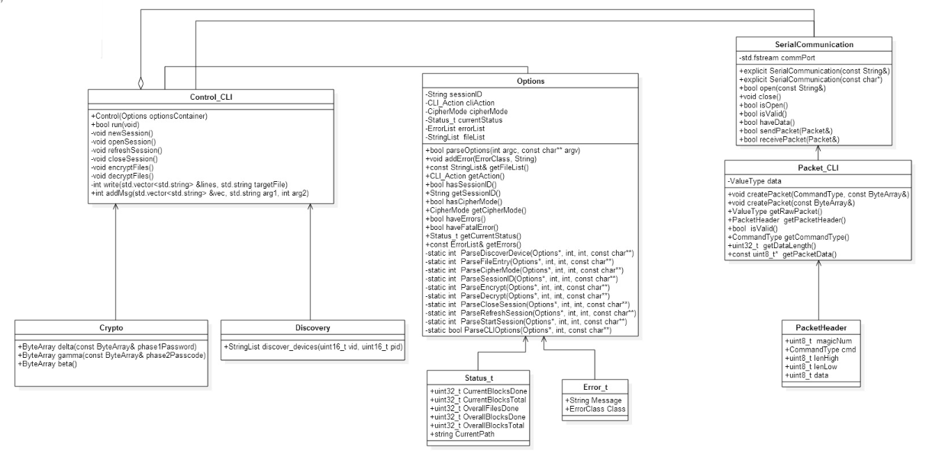
Design: Command line

Slide 8
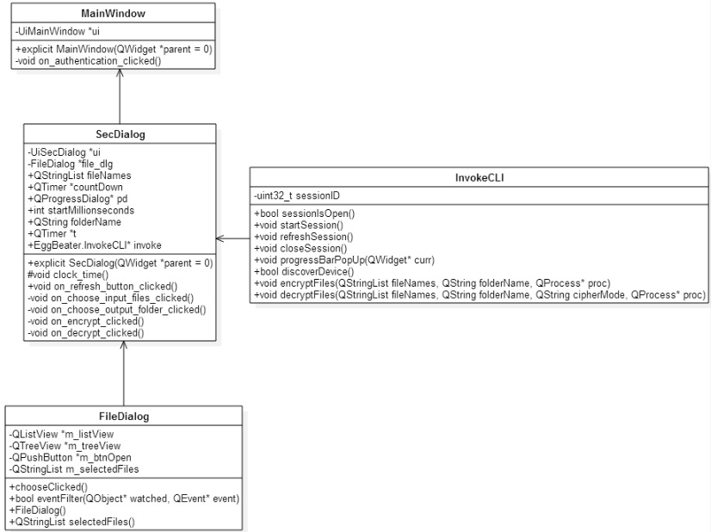
Design: GUI

Slide 9
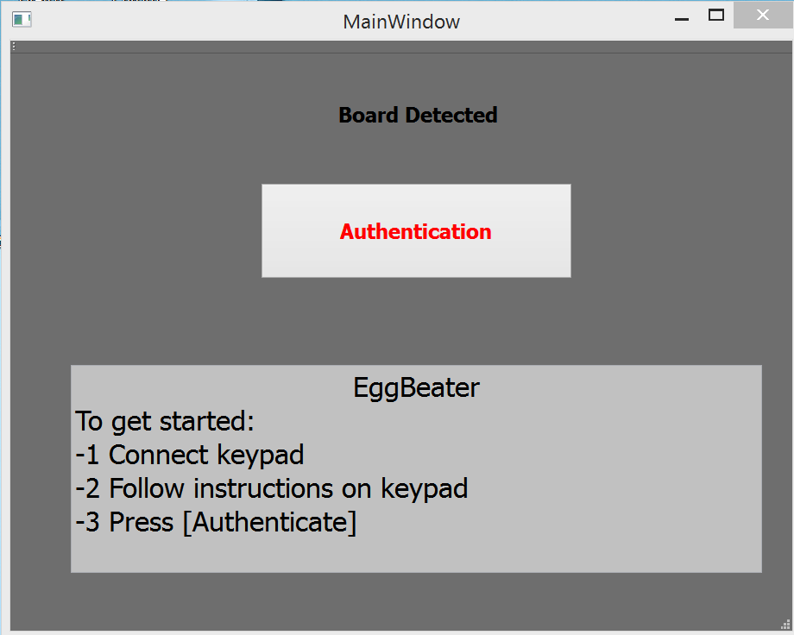
Final GUI Mockup
Notes:
Open GUI and screenshot.

Slide 10
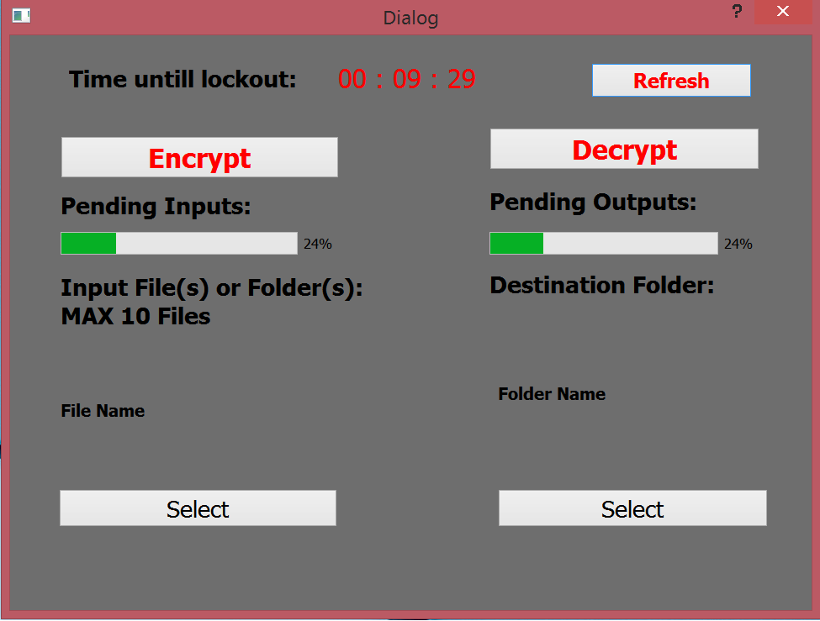
Final GUI Mockup(cont.)

Slide 11
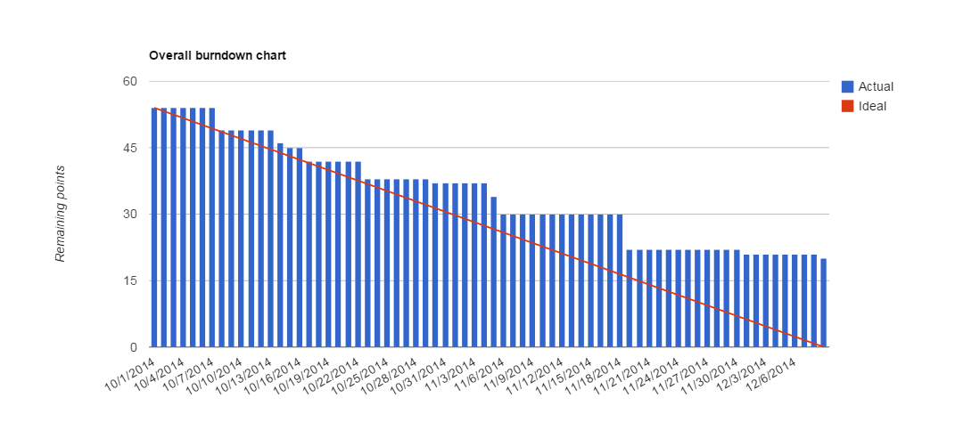
Top-Level Burndown

Slide 12
Testing
Unit testing
Crypto
Command Line
Acceptance testing
Hardware interactions
Device discovery

Slide 13
Test Coverage
Test Coverage
Example -> Encryption Modes
37 Unit Tests & 3 Acceptance Tests
Qt

Slide 14
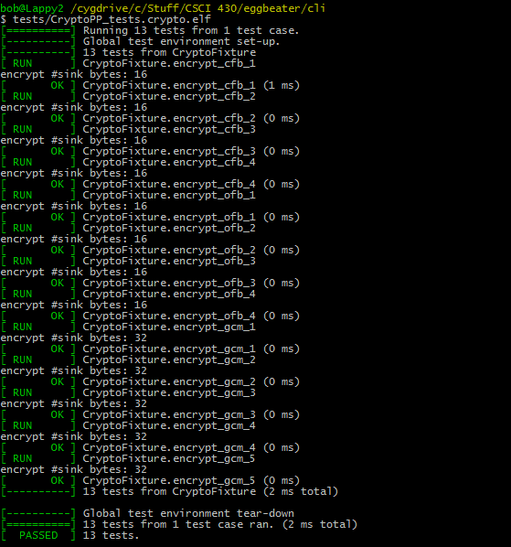
Test Coverage: Example

Slide 15
Metrics
Cyclomatic Complexity
Embedded
Average Complexity = 3.44
Problem Methods
Command Line Interface
Average = 2.44

Slide 16
Maintainability
Split design between three domains
Embedded
Core tool (command line)
GUI wrapper of core tool

Slide 17
Extensibility
Software
Encryption Schemes
GUI options
Mac Compatibility
Linux Compatibility
Qt works!
Hardware
Microcontroller
Keypad

Slide 18
Presented By
Robert Beat
Sterling Miller
Sam Adams
Yuki Ishikawa
Taha Ainaddin
Sam Whitsett
Andrew Barton

